Slide 1

Making Your Own Domain Specific Language
A domain-specific language (DSL) is a computer language specialized to a particular application domain. This is in contrast to a general-purpose language (GPL), which is broadly applicable across domains, and lacks specialized features for a particular domain.
--Wikipedia
Domain: A sphere of knowledge (ontology), influence, or activity. The subject area to which the user applies a program is the domain of the software.
--Wikipedia
Mitchell Harris
@heneryville
github.com/heneryville/MineDefine

Slide 2
Domain Specific Languages You’ve Heard Of
Http
Url
SQL
XML
HTML
JSON
CSS/selectors
Numerals
Hex
Decimal, commas
Roman numerals
Scientific notation
Dates
Addresses
CSV
Pig/Hive
Mathematic Notation (e.g. Integrals)
Phone Numbers
LINQ
Web Routes
Bar Codes
QR codes
Markdown
Twitter hash tags and @
UML
YAML
Version numbers (2.0.1)
IP address
Excel equations
Regular Expressions
Ant/NANT
xPath, xQuery
jPath
XSLT
Graphics turtle language
awk & sed
Make
Post script
PHP ini
Nginx
Scripture book,chapter,verse numerology

Slide 3

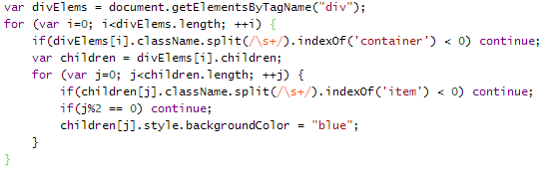
CSS (declarative DSL)
JS (General Purpose)

Slide 4
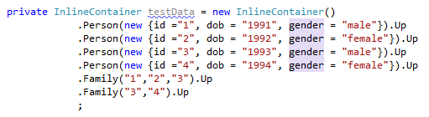
An Internal DSL

Slide 5
MineDefine
@building: { @chair: { 2x1 @cobblestone; up @cobblestone; } @floor: { 10x10x1 @stone; up; 4,5 @chair; wall 10x10x4 @woodplank; } @roof: 10x10x1 @stone; 1x1x10 @floor; top @roof; top 1x1x3 @wood; } @building;
github.com/heneryville/MineDefine

Slide 6
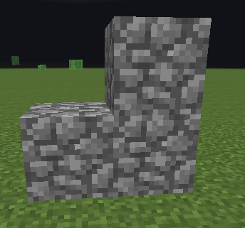
MineDefine
@building: { @chair: { 2x1 @cobblestone; up @cobblestone; } @floor: { 10x10x1 @stone; up; 4,5 @chair; wall 10x10x4 @woodplank; } @roof: 10x10x1 @stone; 1x1x10 @floor; top @roof; top 1x1x3 @wood; } @building;
github.com/heneryville/MineDefine

Slide 7
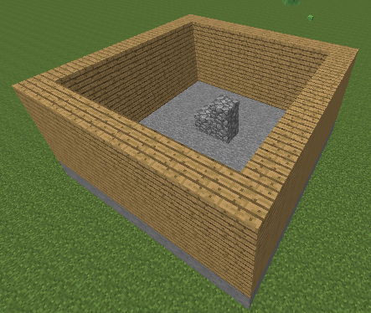
MineDefine
@building: { @chair: { 2x1 @cobblestone; up @cobblestone; } @floor: { 10x10x1 @stone; up; 4,5 @chair; wall 10x10x4 @woodplank; } @roof: 10x10x1 @stone; 1x1x10 @floor; top @roof; top 1x1x3 @wood; } @building;
github.com/heneryville/MineDefine

Slide 8
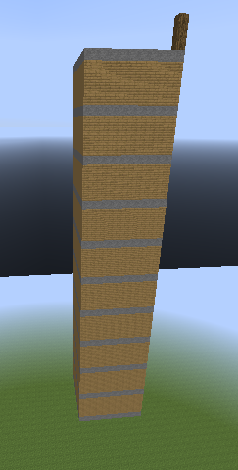
MineDefine
@building: { @chair: { 2x1 @cobblestone; up @cobblestone; } @floor: { 10x10x1 @stone; up; 4,5 @chair; wall 10x10x4 @woodplank; } @roof: 10x10x1 @stone; 1x1x10 @floor; top @roof; top 1x1x3 @wood; } @building;
github.com/heneryville/MineDefine

Slide 9
MineDefine
@building: { @chair: { 2x1 @cobblestone; up @cobblestone; } @floor: { 10x10x1 @stone; up; 4,5 @chair; wall 10x10x4 @woodplank; } @roof: 10x10x1 @stone; 1x1x10 @floor; top @roof; top 1x1x3 @wood; } @building;
github.com/heneryville/MineDefine

Slide 10
Parts of a Compiler
Stream<Char>
Stream<Token>
Abstract Syntax Tree (AST)
Lexer
Parser
Synthesis

Slide 11
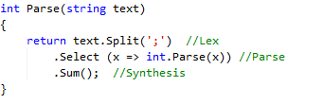
Super Simple DSL

Slide 12
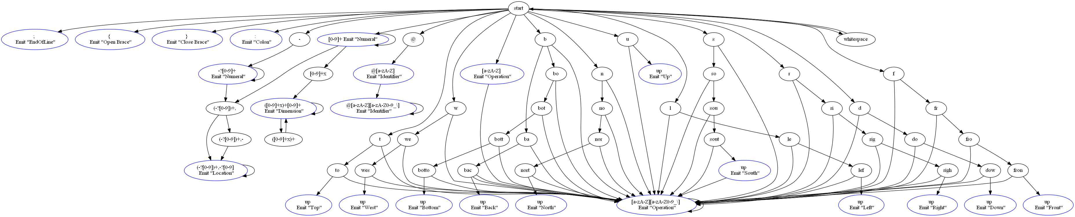
MineDefine Finite State Machine

Slide 13
MineDefine Finite State Machine

Slide 14
Parts of a Compiler
Stream<Char>
Stream<Token>
Abstract Syntax Tree (AST)
Lexer
Parser
Synthesis
@building: { @chair: { 2x1 @cobblestone; up @cobblestone; } @floor: { 10x10x1 @stone; up; 4,5 @chair; wall 10x10x4 @woodplank; } @roof: 10x10x1 @stone; 1x1x10 @floor; top @roof; top 1x1x3 @wood; } @building;
Identifier (@building), Colon, OpenBrace, Identifier (@chair), Colon, OpenBrace, Dimension (2x1), Identifier (@cobblestone), EndOfLine, Up, Identifier (@cobblestone), EndOfLine, CloseBrace, Identifier (@floor), Colon, OpenBrace, Dimension (10x10x1), Identifier (@stone), EndOfLine, Up, EndOfLine, Location (4,5), Identifier (@chair), EndOfLine,
Operation (wall), Dimension (10x10x4), Identifier (@woodplank), EndOfLine, CloseBrace, Identifier (@roof), Colon, Dimension (10x10x1), Identifier (@stone), EndOfLine, Dimension (1x1x10), Identifier (@floor), EndOfLine, Top, Identifier (@roof), EndOfLine, Top, Dimension (1x1x3), Identifier (@wood), EndOfLine, CloseBrace, Identifier (@building), EndOfLine

Slide 15
MineDefine BNF
<prgm> ::= <statement>*
<statement> ::= <definition> | <invocation>| <transform>
<definition> ::= identifier: <statement_block>
<statement_block> ::= <statement> | { <statement>* }
<transform> ::= <trans_instructions> <statement_block>|<trans_instructions>;
<trans_instructions> ::= <absoulte_trans> | <relative_trans>
<absolute_trans> ::= (up|down|north|south|east|west) integer?
<relative_trans> ::= (top|bottom|left|right|front|back)
<invocation> ::= <shape>? <dimension>? <location>? identifier;

Slide 16
Parts of a Compiler
Stream<Char>
Stream<Token>
Abstract Syntax Tree (AST)
Lexer
Parser
Synthesis
@building: { @chair: { 2x1 @cobblestone; up @cobblestone; } @floor: { 10x10x1 @stone; up; 4,5 @chair; wall 10x10x4 @woodplank; } @roof: 10x10x1 @stone; 1x1x10 @floor; top @roof; top 1x1x3 @wood; } @building;
Identifier (@building), Colon, OpenBrace, Identifier (@chair), Colon, OpenBrace, Dimension (2x1), Identifier (@cobblestone), EndOfLine, Up, Identifier (@cobblestone), EndOfLine, CloseBrace, Identifier (@floor), Colon, OpenBrace, Dimension (10x10x1), Identifier (@stone), EndOfLine, Up, EndOfLine, Location (4,5), Identifier (@chair), EndOfLine,
Operation (wall), Dimension (10x10x4), Identifier (@woodplank), EndOfLine, CloseBrace, Identifier (@roof), Colon, Dimension (10x10x1), Identifier (@stone), EndOfLine, Dimension (1x1x10), Identifier (@floor), EndOfLine, Top, Identifier (@roof), EndOfLine, Top, Dimension (1x1x3), Identifier (@wood), EndOfLine, CloseBrace, Identifier (@building), EndOfLine
Program
.Definition: building
..Definition: chair
...Build: 2x1x1 cobblestone
...Transform: Up 1
....Build: cobblestone
..Definition: floor
...Build: 10x10x1 stone
...Transform: Up 1
...Build: 4,5,0 chair
...Build: Wall 10x10x4 woodplank
..Definition: roof
...Build: 10x10x1 stone
..Build: 1x1x10 floor
..Transform: Top
...Build: roof
..Transform: Top
...Build: 1x1x3 wood
.Build: building

Slide 17

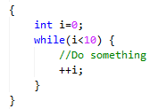
Lowering (Syntactic Sugar)

